Slide 1
Spatial and Temporal Data Mining
Data Preprocessing
Vasileios Megalooikonomou
(based on notes by Jiawei Han and Micheline Kamber)

Slide 2
Agenda
Why data preprocessing?
Data cleaning
Data integration and transformation
Data reduction
Discretization and concept hierarchy generation
Summary

Slide 3
Why Data Preprocessing?
Data in the real world is dirty
  incomplete: lacking attribute values, lacking certain attributes of interest, or containing only aggregate data
  noisy: containing errors or outliers
  inconsistent: containing discrepancies in codes or names
No quality data, no quality mining results!
  Quality decisions must be based on quality data
  Data warehouse needs consistent integration of quality data
A multi-dimensional measure of data quality:
  A well-accepted multi-dimensional view:
    accuracy, completeness, consistency, timeliness, believability, value added, interpretability, accessibility
  Broad categories:
    intrinsic, contextual, representational, and accessibility.

Slide 4
Major Tasks in Data Preprocessing
Data cleaning
  Fill in missing values, smooth noisy data, identify or remove outliers, and resolve inconsistencies
Data integration
  Integration of multiple databases, data cubes, files, or notes
Data transformation
  Normalization (scaling to a specific range)
  Aggregation
Data reduction
  Obtains reduced representation in volume but produces the same or similar analytical results
  Data discretization: with particular importance, especially for numerical data
  Data aggregation, dimensionality reduction, data compression,generalization

Slide 5

Forms of data preprocessing

Slide 6
Agenda
Why preprocess the data?
Data cleaning
Data integration and transformation
Data reduction
Discretization and concept hierarchy generation
Summary

Slide 7
Data Cleaning
Data cleaning tasks
  Fill in missing values
  Identify outliers and smooth out noisy data
  Correct inconsistent data

Slide 8
Missing Data
Data is not always available
  E.g., many tuples have no recorded value for several attributes, such as customer income in sales data
Missing data may be due to
  equipment malfunction
  inconsistent with other recorded data and thus deleted
  data not entered due to misunderstanding
  certain data may not be considered important at the time of entry
  not register history or changes of the data
Missing data may need to be inferred

Slide 9
How to Handle Missing Data?
Ignore the tuple: usually done when class label is missing (assuming the task is classification—not effective in certain cases)
Fill in the missing value manually: tedious + infeasible?
Use a global constant to fill in the missing value: e.g., “unknown”, a new class?!
Use the attribute mean to fill in the missing value
Use the attribute mean for all samples of the same class to fill in the missing value: smarter
Use the most probable value to fill in the missing value: inference-based such as regression, Bayesian formula, decision tree

Slide 10
Noisy Data
Q: What is noise?
A: Random error in a measured variable.
Incorrect attribute values may be due to
  faulty data collection instruments
  data entry problems
  data transmission problems
  technology limitation
  inconsistency in naming convention
Other data problems which requires data cleaning
  duplicate records
  incomplete data
  inconsistent data

Slide 11
How to Handle Noisy Data?
Binning method:
  first sort data and partition into (equi-depth) bins
  then one can smooth by bin means, smooth by bin median, smooth by bin boundaries, etc.
  used also for discretization (discussed later)
Clustering
  detect and remove outliers
Semi-automated method: combined computer and human inspection
  detect suspicious values and check manually
Regression
  smooth by fitting the data into regression functions

Slide 12
Simple Discretization Methods: Binning
Equal-width (distance) partitioning:
  It divides the range into N intervals of equal size: uniform grid
  if A and B are the lowest and highest values of the attribute, the width of intervals will be: W = (B-A)/N.
  The most straightforward
  But outliers may dominate presentation
  Skewed data is not handled well.
Equal-depth (frequency) partitioning:
  It divides the range into N intervals, each containing approximately same number of samples
  Good data scaling
  Managing categorical attributes can be tricky.

Slide 13
Binning Methods for Data Smoothing
* Sorted data for price (in dollars): 4, 8, 9, 15, 21, 21, 24, 25, 26, 28, 29, 34
* Partition into (equi-depth) bins:
- Bin 1: 4, 8, 9, 15
- Bin 2: 21, 21, 24, 25
- Bin 3: 26, 28, 29, 34
* Smoothing by bin means:
- Bin 1: 9, 9, 9, 9
- Bin 2: 23, 23, 23, 23
- Bin 3: 29, 29, 29, 29
* Smoothing by bin boundaries:
- Bin 1: 4, 4, 4, 15
- Bin 2: 21, 21, 25, 25
- Bin 3: 26, 26, 26, 34

Slide 14
Cluster Analysis

Slide 15
Regression
y
Y1
Y1’
y = x + 1
X1
x
Linear regression (best line to fit
two variables)
Multiple linear regression (more
than two variables, fit to a
multidimensional surface

Slide 16
How to Handle Inconsistent Data?
Manual correction using external references
Semi-automatic using various tools
  To detect violation of known functional dependencies and data constraints
  To correct redundant data

Slide 17
Agenda
Why preprocess the data?
Data cleaning
Data integration and transformation
Data reduction
Discretization and concept hierarchy generation
Summary

Slide 18
Data Integration
Data integration:
  combines data from multiple sources into a coherent store
Schema integration
  integrate metadata from different sources
  Entity identification problem: identify real world entities from multiple data sources, e.g., A.cust-id ≡ B.cust-#
Detecting and resolving data value conflicts
  for the same real world entity, attribute values from different sources are different
  possible reasons: different representations, different scales, e.g., metric vs. British units, different currency

Slide 19
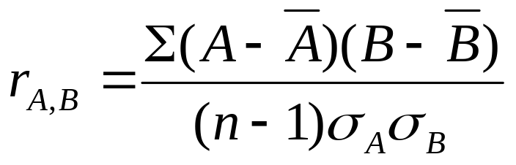
Handling Redundant Data in Data Integration
Redundant data occur often when integrating multiple DBs
  The same attribute may have different names in different databases
  One attribute may be a “derived” attribute in another table, e.g., annual revenue
Redundant data may be able to be detected by correlational analysis
Careful integration can help reduce/avoid redundancies and inconsistencies and improve mining speed and quality

Slide 20
Data Transformation
Smoothing: remove noise from data (binning, clustering, regression)
Aggregation: summarization, data cube construction
Generalization: concept hierarchy climbing
Normalization: scaled to fall within a small, specified range
  min-max normalization
  z-score normalization
  normalization by decimal scaling
Attribute/feature construction
  New attributes constructed from the given ones

Slide 21




Data Transformation: Normalization
Particularly useful for classification (NNs, distance measurements,
nn classification, etc)
min-max normalization
z-score normalization
normalization by decimal scaling
Where j is the smallest integer such that Max(| |)<1

Slide 22
Agenda
Why preprocess the data?
Data cleaning
Data integration and transformation
Data reduction
Discretization and concept hierarchy generation
Summary

Slide 23
Data Reduction
Problem:
Data Warehouse may store terabytes of data: Complex data analysis/mining may take a very long time to run on the complete data set
Solution?
  Data reduction…

Slide 24
Data Reduction
Obtains a reduced representation of the data set that is much smaller in volume but yet produces the same (or almost the same) analytical results
Data reduction strategies
  Data cube aggregation
  Dimensionality reduction
  Data compression
  Numerosity reduction
  Discretization and concept hierarchy generation

Slide 25
Data Cube Aggregation
Multiple levels of aggregation in data cubes
  Further reduce the size of data to deal with
Reference appropriate levels
  Use the smallest representation capable to solve the task
Queries regarding aggregated information should be answered using data cube, when possible

Slide 26
Dimensionality Reduction
Problem: Feature selection (i.e., attribute subset selection):
  Select a minimum set of features such that the probability distribution of different classes given the values for those features is as close as possible to the original distribution given the values of all features
  Nice side-effect: reduces # of attributes in the discovered patterns (which are now easier to understand)
Solution: Heuristic methods (due to exponential # of choices) usually greedy:
  step-wise forward selection
  step-wise backward elimination
  combining forward selection and backward elimination
  decision-tree induction

Slide 27
Example of Decision Tree Induction
nonleaf nodes: tests
branches: outcomes of tests
leaf nodes: class prediction
Initial attribute set:
{A1, A2, A3, A4, A5, A6}
A4 ?
A1?
A6?
Class 1
Class 2
Class 1
Class 2
>
Reduced attribute set: {A1, A4, A6}

Slide 28
Heuristic Feature Selection Methods
There are 2^{d} possible sub-features of d features
Several heuristic feature selection methods:
  Best single features under the feature independence assumption: choose by significance tests.
  Step-wise feature selection:
    The best single-feature is picked first
    Then next best feature condition to the first, ...
  Step-wise feature elimination:
    Repeatedly eliminate the worst feature
  Combined feature selection and elimination:
  Optimal branch and bound:
    Use feature elimination and backtracking

Slide 29
Data Compression
String compression
  There are extensive theories and well-tuned algorithms
  Typically lossless
  But only limited manipulation is possible without expansion
Audio/video, image compression
  Typically lossy compression, with progressive refinement
  Sometimes small fragments of signal can be reconstructed without reconstructing the whole
Time sequence is not audio
  Typically short and vary slowly with time

Slide 30
Data Compression
Original Data
Compressed
Data
lossless
Original Data
Approximated
lossy

Slide 31
Wavelet Transforms
Discrete wavelet transform (DWT):
linear signal processing
Compressed approximation: store only a small fraction of the strongest of the wavelet coefficients
Similar to discrete Fourier transform (DFT), but better lossy compression, localized in space (conserves local details)
Method (hierarchical pyramid algorithm):
  Length, L, must be an integer power of 2 (padding with 0s, when necessary)
  Each transform has 2 functions:
    smoothing (e.g., sum, weighted avg.), weighted difference
  Applies to pairs of data, resulting in two sets of data of length L/2
  Applies the two functions recursively, until reaches the desired length
Haar2
Daubechie4

Slide 32
Principal Component Analysis (PCA)
Karhunen-Loeve (K-L) method
Given N data vectors from k-dimensions, find
c <= k orthogonal vectors that can be best used to represent data
  The original data set is reduced (projected) to one consisting of N data vectors on c principal components (reduced dimensions)
Each data vector is a linear combination of the c principal component vectors
Works for ordered and unordered attributes
Used when the number of dimensions is large

Slide 33
Principal Component Analysis
The principal components (new set of axes) give important information about variance.
Using the strongest components one can reconstruct a good approximation of the original signal.
X2
Y1
Y2
X1

Slide 34
Numerosity Reduction
Parametric methods
  Assume the data fits some model, estimate model parameters, store only the parameters, and discard the data (except possible outliers)
  E.g.: Log-linear models: obtain value at a point in m-D space as the product on appropriate marginal subspaces
Non-parametric methods
  Do not assume models
  Major families: histograms, clustering, sampling

Slide 35
Regression and Log-Linear Models
Linear regression: Data are modeled to fit a straight line:
  Often uses the least-square method to fit the line
Multiple regression: allows a response variable y to be modeled as a linear function of multidimensional feature vector (predictor variables)
Log-linear model: approximates discrete multidimensional joint probability distributions

Slide 36
Regression Analysis and Log-Linear Models
Linear regression: Y = α + β X
  Two parameters , α and β specify the line and are to be estimated by using the data at hand.
  using the least squares criterion to the known values of Y1, Y2, …, X1, X2, ….
Multiple regression: Y = b0 + b1 X1 + b2 X2.
  Many nonlinear functions can be transformed into the above.
Log-linear models:
  The multi-way table of joint probabilities is approximated by a product of lower-order tables.
  Probability: p(a, b, c, d) = αab βacχad δbcd

Slide 37
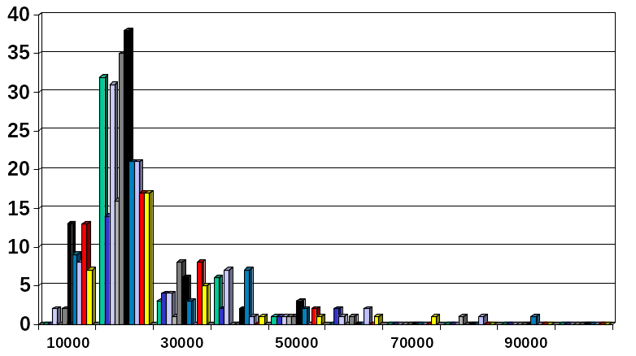
Histograms
Approximate data distributions
Divide data into buckets and store average (sum) for each bucket
A bucket represents an attribute-value/frequency pair
Can be constructed optimally in one dimension using dynamic programming
Related to quantization problems.

Slide 38
Clustering
Partition data set into clusters, and store cluster representation only
Quality of clusters measured by their diameter (max distance between any two objects in the cluster) or centroid distance (avg. distance of each cluster object from its centroid)
Can be very effective if data is clustered but not if data is “smeared”
Can have hierarchical clustering (possibly stored in multi-dimensional index tree structures (B+-tree, R-tree, quad-tree, etc))
There are many choices of clustering definitions and clustering algorithms (further details later)

Slide 39
Sampling
Allow a mining algorithm to run in complexity that is potentially sub-linear to the size of the data
Cost of sampling: proportional to the size of the sample, increases linearly with the number of dimensions
Choose a representative subset of the data
  Simple random sampling may have very poor performance in the presence of skew
Develop adaptive sampling methods
  Stratified sampling:
    Approximate the percentage of each class (or subpopulation of interest) in the overall database
    Used in conjunction with skewed data
Sampling may not reduce database I/Os (page at a time).
Sampling: natural choice for progressive refinement of a reduced data set.

Slide 40
Sampling
SRSWOR
(simple random
sample without
replacement)
SRSWR
Raw Data

Slide 41
Sampling
Raw Data
Cluster/Stratified Sample

Slide 42
Hierarchical Reduction
Use multi-resolution structure with different degrees of reduction
Hierarchical clustering is often performed but tends to define partitions of data sets rather than “clusters”
Parametric methods are usually not amenable to hierarchical representation
Hierarchical aggregation
  An index tree hierarchically divides a data set into partitions by value range of some attributes
  Each partition can be considered as a bucket
  Thus an index tree with aggregates stored at each node is a hierarchical histogram

Slide 43
Agenda
Why preprocess the data?
Data cleaning
Data integration and transformation
Data reduction
Discretization and concept hierarchy generation
Summary

Slide 44
Discretization/Quantization
Three types of attributes:
  Nominal — values from an unordered set
  Ordinal — values from an ordered set
  Continuous — real numbers
Discretization/Quantization:
  divide the range of a continuous attribute into intervals
  Some classification algorithms only accept categorical attributes.
  Reduce data size by discretization
  Prepare for further analysis
x1
x2
x3
x4
x5
y1
y2
y3
y4
y5
y6

Slide 45
Discretization and Concept Hierarchy
Discretization
  reduce the number of values for a given continuous attribute by dividing the range of the attribute into intervals. Interval labels can then be used to replace actual data values.
Concept Hierarchies
  reduce the data by collecting and replacing low level concepts (such as numeric values for the attribute age) by higher level concepts (such as young, middle-aged, or senior).

Slide 46
Discretization and concept hierarchy generation for numeric data
Hierarchical and recursive decomposition using:
  Binning (data smoothing)
  Histogram analysis (numerosity reduction)
  Clustering analysis (numerosity reduction)
Entropy-based discretization
Segmentation by natural partitioning

Slide 47
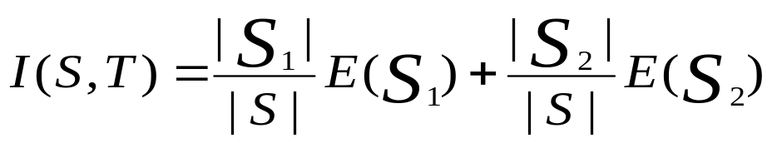
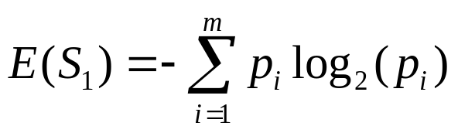

Entropy-Based Discretization
Given a set of samples S, if S is partitioned into two intervals S1 and S2 using threshold T on the value of attribute A, the information gain resulting from the partitioning is:
where the entropy function E for a given set is calculated based on the class distribution of the samples in the set. Given m classes the entropy of S1 is:
where pi is the probability of class i in S1.
The threshold that maximizes the information gain over all possible thresholds is selected as a binary discretization.
The process is recursively applied to partitions obtained until some stopping criterion is met, e.g.,
Experiments show that it may reduce data size and improve classification accuracy

Slide 48
Segmentation by natural partitioning
3-4-5 rule can be used to segment numeric data into relatively uniform, “natural” intervals.
It partitions a given range into 3,4, or 5 equiwidth intervals recursively level-by-level based on the value range of the most significant digit.
* If an interval covers 3, 6, 7 or 9 distinct values at the most significant digit, partition the range into 3 equi-width intervals
* If it covers 2, 4, or 8 distinct values at the most significant digit, partition the range into 4 intervals
* If it covers 1, 5, or 10 distinct values at the most significant digit, partition the range into 5 intervals

Slide 49
Example of 3-4-5 rule
count
Step 1:
-$351 -$159 profit $1,838 $4,700
Min Low (i.e, 5%-tile) High(i.e, 95%-0 tile) Max
Step 2:
msd=1,000 Low=-$1,000 High=$2,000
Step 3:
(-$1,000 - $2,000)
(-$1,000 - 0)
(0 -$ 1,000)
($1,000 - $2,000)
Step 4:
(-$4000 -$5,000)
(-$400 - 0)
(0 - $1,000)
($1,000 - $2, 000)
($2,000 - $5, 000)
(0 -
$200)
($1,000 -
$1,200)
(-$400 -
-$300)
($2,000 -
$3,000)
($200 -
$400)
($1,200 -
$1,400)
(-$300 -
-$200)
($3,000 -
$4,000)
($400 -
$600)
($1,400 -
$1,600)
(-$200 -
-$100)
($4,000 -
$5,000)
($600 -
$800)
($1,600 -
$1,800)
($1,800 -
$2,000)
($800 -
$1,000)
(-$100 -
0)

Slide 50
Concept hierarchy generation for categorical data
Categorical data: no ordering among values
Specification of a partial ordering of attributes explicitly at the schema level by users or experts
Specification of a portion of a hierarchy by explicit data grouping
Specification of a set of attributes, but not of their partial ordering
Specification of only a partial set of attributes

Slide 51
Concept hierarchy generation w/o data semantics - Specification of a set of attributes
Concept hierarchy can be automatically generated based on the number of distinct values per attribute in the given attribute set. The attribute with the most distinct values is placed at the lowest level of the hierarchy (limitations?)
country
15 distinct values
province_or_ state
65 distinct values
city
3567 distinct values
street
674,339 distinct values

Slide 52
Agenda
Why preprocess the data?
Data cleaning
Data integration and transformation
Data reduction
Discretization and concept hierarchy generation
Summary

Slide 53
Summary
Data preparation is a big issue for both warehousing and mining
Data preparation includes
  Data cleaning and data integration
  Data reduction and feature selection
  Discretization
A lot a methods have been developed but still an active area of research

